Slide 1
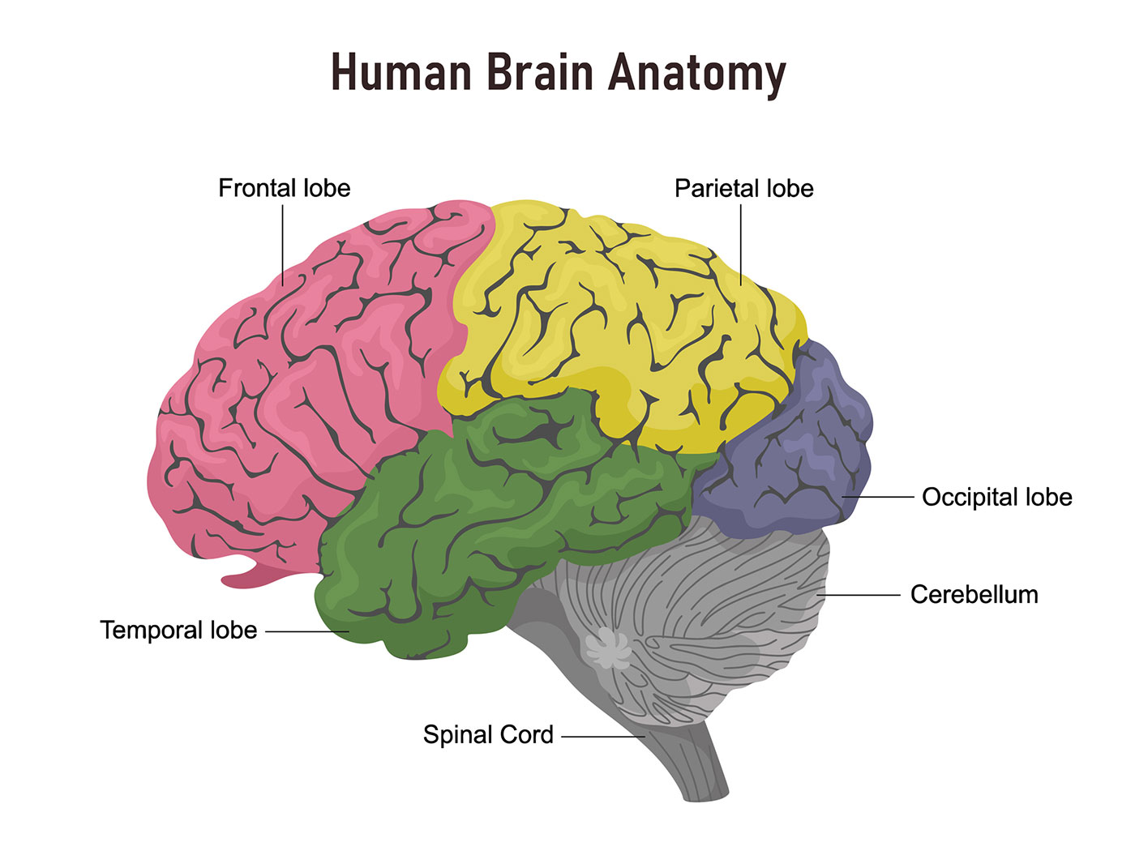
Extras

Slide 2
Resting-State fMRI
rs-fMRI does not require subjects to perform a task or respond to stimuli. Subjects are asked to rest in the scanner a few minutes with their eyes closed or staring at a fixed point while whole-brain BOLD data is collected; as it is cheap to acquire and contains much intrinsic information about brain functioning.
Rs-fMRI has permitted the discovery of at least 20 distinct patterns of brain connections called resting-state networks (RSNs). These networks have provided significant insights into the cognitive organization of the brain in health and disease. The functional network which has been the most studied by resting-state fMRI is the default mode network.

Slide 3
Functional Segregation Methods for Identifying Neural Networks
Functional segregation divides the brain into regions according to their specific functions and is mainly used for brain mapping . The Amplitude of Low-Frequency Fluctuations (ALFF) and regional homogeneity (ReHo) are methods commonly used in functional segregation assessments

Slide 4
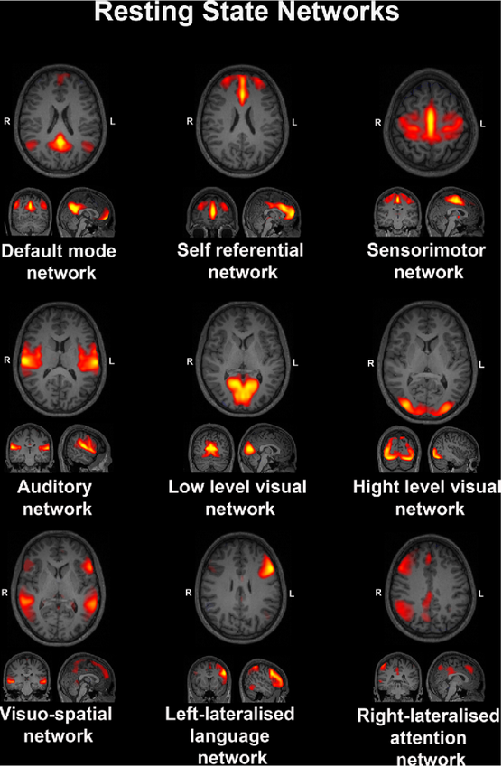
Some important resting-state networks (RSNs) and their
corresponding node regions

Slide 5
ALFF Analysis
The Amplitude of low-frequency fluctuation (ALFF) was introduced as a measure the total power within the frequency range between 0.01 and 0.1 Hz and considered as an effective approach to detect the regional intensity of spontaneous fluctuations and to reflect spontaneous brain activity of the brain in the BOLD signal of the rs-fMRI

Slide 6
Regional Homogeneity Analysis
ReHo is a voxel-wise measure of the synchronization of the time-series of a given voxel and its adjacent neighboring voxels, Figure in next slide shows That the measure is calculated by the Kendall coefficient of concordance of the BOLD time-series. The ReHo algorithm was based on the hypothesis that intrinsic brain activity is manifested by clusters of voxels rather than single voxels. It requires no a priori definition of ROIs and can provide information about the local or regional activity of regions throughout the brain and has been applied to different diseases

Slide 7
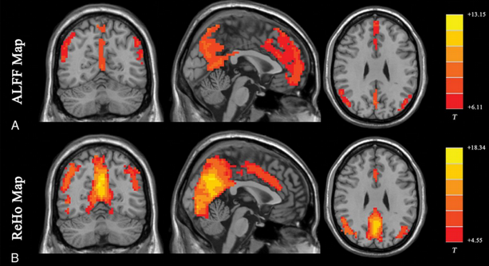
Results of ALFF and ReHo studies.
Both ALFF and ReHo results reflect regional neural activities. ALFF is focused on measuring the strength of the activity, while ReHo is more specific for coherence and centrality of regional activity. T indicates peak intensity.

Slide 8
Clustering Analysis
Clustering analysis approach aims to parcellate the brain into different clusters on the basis of a collection of relevant features such that similarity within clusters is higher than the similarity between clusters. A distance metric is used to group a set of voxels or ROIs into the same cluster according to the similarity in their BOLD time courses. Obviously, if the cluster number is correctly chosen, voxels belonging to the same functional network will fall within the same cluster. Several approaches have been proposed in the literature for clustering analysis of rs-fMRI data,

Slide 9
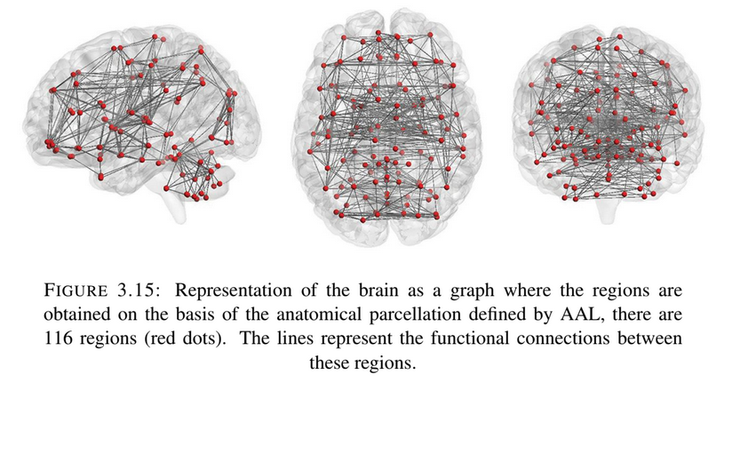
Graph Analysis

Slide 10
Functional Connectivity Analysis
The human brain is a complex network of a large number of different brain regions that each have their own task and function, but are functionally and structurally interconnected regions. Brain function is not only the result of activity in different specialized and isolated brain regions but also the result of interactions between brain regions. Interactions between brain regions are likely to play a key role in complex cognitive processes, making the examination of functional connectivity in the human brain very important and providing important new information on the core organization of the human brain. Functional connectivity (FC) is defined as the temporal correlation between the time series of different brain regions, reflecting the level of functional communication between regions. More generally, functional connectivity between two given regions is considered in terms of the temporal coherence or correlation between the oscillatory firing rate of neuronal assemblies.

Slide 11
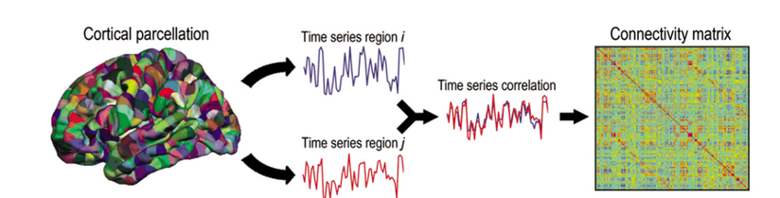
Analysis of functional connectivity can be carried out at the level of the individual voxels or at the level of regions of interest (ROIs). Methods for functional connectivity analysis are always based on some measure related to the correlation between two or more fMRI time series. The results of functional connectivity are usually represented by a matrix called the connectivity matrix, which is typically estimated using the correlation between time series, where each cell in the connectivity matrix contains a correlation coefficient that crosses the correlation between two regions of the brain,

Slide 12
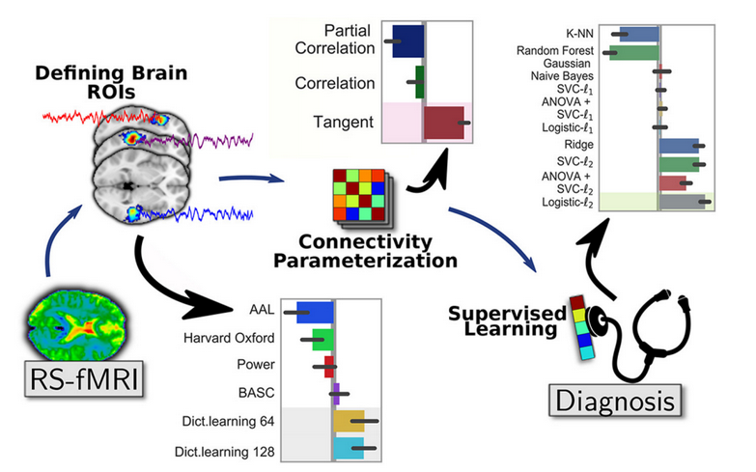
A general pipeline for rs-fMRI functional connectivity-based prediction with three main steps: 1) Definition of brain regions (ROIs) from rest- fMRI images or using already defined reference atlases, 2) building the functional connectivity matrix from time-series signals extracted from these ROIs for every subject and 3) comparisons of functional connectivity matrices across subjects using machine learning algorithms.

Slide 13
Graph Matching
Graph matching is the process of finding a correspondence between the nodes and the edges of two or more graphs that satisfies some (more or less stringent) constraints ensuring that similar substructures in one graph are mapped to similar substructures in the others. In realistic applications, the matching is done by comparing the model graph which is stored in a file and an input graph that is given at the run time. Computing the similarity of two graphs is typically exponential in the number of nodes of the two graphs involved.

Slide 14
Exact Graph Matching & Inexact Graph Matching
In exact graph matching, the objective is to determine the mapping between the nodes of two graphs must be edge-preserving in the sense that if two nodes in the first graph are linked by an edge, they are mapped to two nodes in the second graph that is linked by an edge as well, the mapping must be bijective.
In graph representations of real-world problems, it is often the case that graphs from the same class differ due to several causes: Intrinsic pattern variability, noise in the acquisition phase, the existence of non-deterministic elements in the processing steps leading to the graph representation,are among the possible reasons for having actual graphs that differ somewhat from their ideal models. Hence, the graph matching process needs to take structural errors into account and must be tolerant.

Slide 15
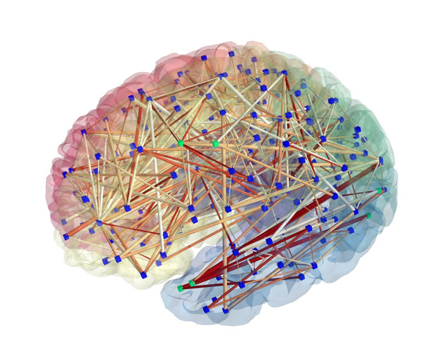
Representing Brain MRI/FMRI Data by Graphs
fMRI Data
• Nodes: stand for different brain regions (e.g. parcellated areas or recording sites), there are several approaches to define brain nodes in fMRI data. The most commonly used approach is to use a fixed anatomical atlas. Using single voxels directly as brain nodes was the earliest approach for graph analysis [244]. Approaches to aggregate voxels into nodes as voxel-based modalities and independent component analysis ].
• Edges: In fMRI, the links of a brain graph are given by evaluating the similarity between two brain signals, through FC measures. Several approaches have been developed in the last decade to measure FC based on various concepts from signal processing to autoregressive modeling and information theory.

Slide 16
Topological Metrics
The comparison of brain graphs in terms of topological metrics is often achieved by comparing theoretical reference graphs produced by simulation models or by comparing the collection of brain graphs, either between specific experimental conditions or different populations. Recently, several empirical studies on structural and functional brain networks have contained small-world architectures. Discovering that brain networks are small-world networks is only the first step towards a comprehensive understanding of how these networks are structurally organized and how they generate complex dynamics. Topological properties of brain networks can be derived at the large scale of the whole brain, at the intermediate-scale of several regions of the brain, or locally, at the small-scale of single regions, i.e. metrics on single nodes.

Slide 17
Centrality metrics such as degree, betweenness, closeness and eigenvector centrality are used to identify the crucial areas within the network. Community structure analysis, which detects the groups of regions more densely connected between themselves than expected by chance, is also essential for understanding brain network organization and topology

